Slide 1


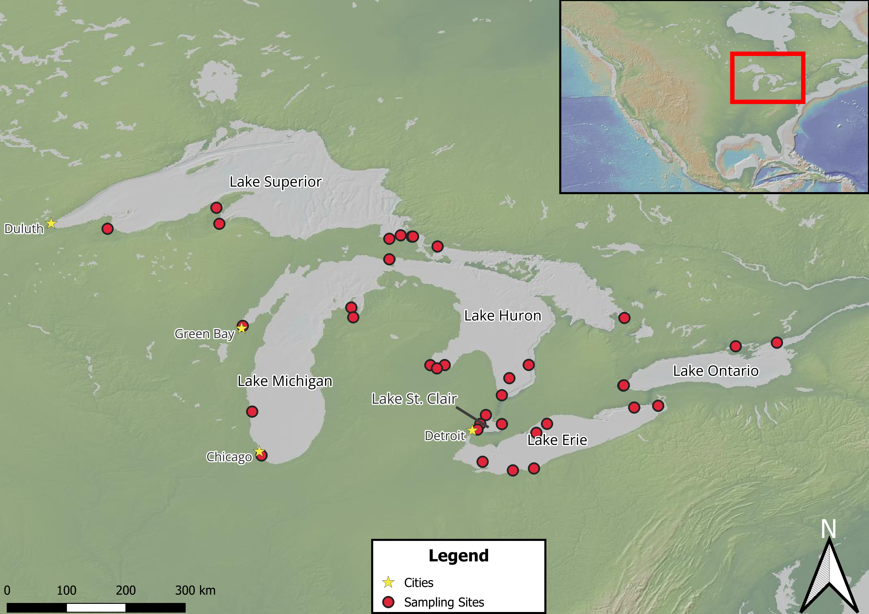
Seasonal variation in microbial community dynamics and organic matter in the Great Lakes
Connor O’Loughlin¹, Gord Paterson¹, Nicole Wagner², Hunter Carrick³, Jonathan Doubek⁴, Donald Uzarski³, Trista J. Vick-Majors¹, with the Winter Grab Network
¹Michigan Technological University, ²Oakland University, ³Central Michigan University, ⁴Lake Superior State University
Introduction
Winter has been regarded as a period of relative dormancy in limnetic systems¹, characterized by low biological activity.
Recent work has shown that microbial communities remain active during winter², and important biogeochemical processes still occur
We present work aimed at understanding the microbial ecology of the Laurentian Great Lakes during winter.
DOM Quality in Laurentian Great Lakes
Relationships Between Leu:TdR, Nutrients, and DOC
Table 1. A data table showing the results of a standardized major axis type II linear regression, with each variable log transformed. Each variable was modeled with Leu:TdR (A larger Leu:TdR value indicates bacterial maintenance prevails over bacterial growth). The sample size, Pearson coefficient, slope, and 95% confidence interval are provided. Nutrient data for both winters (2024 and 2025) were not available and therefore only summer and spring data was used.
Variable | Sample Size | Pearson Coefficient | Slope | 95% CI
DOC | 33 | -0.21 | -2.15 | -3.04,-1.52
NH₄ μg L⁻¹ | 23 | -0.079 | -1.65 | -2.59,-1.05
P μg L⁻¹ | 23 | -0.12 | -1.25 | -1.96,-0.80
Hypotheses
Microbial activity across years, lakes, and seasons will vary, with a depressed level of activity in winter, marked by a relative decrease in bacterial production.
Dissolved organic carbon (DOC) and organic matter will vary between seasons and between lakes.
Nutrient availability and DOC concentration will have a negative relationship with microbial activity, marked by a trend towards bacterial growth.
Figure 2. Bar charts showing average Humification index (HIX; A) and Biological index (BIX; B) values by year and season for each lake. The error bars represent the standard error of the mean with sample size shown above each bar. Higher HIX values indicate extent of humification, and higher BIX values indicate autotrophic productivity³.
Dissolved Organic Carbon Concentration
Conclusions
HIX remained relatively stable year-round, with each lake displaying unique shifts in HIX, and summer often having the lowest values (Figure 2).
BIX values were more variable between lakes and seasons, indicating differences in autotrophic productivity linked to season and lake (Figure 2).
Lake Huron DOC concentrations were unusually high in winter, however the sample size is small. Summer DOC was consistently the highest across lakes (Figure 3).
Winter 2025 bacterial production was lowest across lakes. Summer and spring bacterial production were the highest, with a distinct shift to bacterial growth (Figure 4).
DOC, NH₄, and P showed weak negative correlations with Leu:TdR (Table 1). The relationships are very weak and require additional parameters to generate a more robust model.
Methods
Bacterial production was measured via incubations with tritiated leucine and thymidine.
Dissolved organic matter (DOM) was characterized using via fluorescence excitation-emission matrix spectroscopy.
Raw water samples were used to measure DOC, inorganic nitrogen, and phosphorus concentrations.
Figure 3. A bar chart showing mean DOC concentration by year and season for each lake. The error bars represent the standard error with the sample size shown above. Data for winter 2025 has not be analyzed yet and therefore not shown.
Seasonal and Annual Bacterial Production
Future Directions
Make a mixed effect linear model that includes biological, chemical, and physical parameters.
Incorporate winter 2025 analyses into analyses.
Acknowledgements
We would like to thank Maci Quintanilla, Garrett Lukosavich, Mitch Kehne, Allen Cureton, Mari Leland, K.M. Shafi, and An Nguyen for assistance with sample collection and lab work, the Great Lakes Research Center for providing logistical and financial support, and the Great Lakes Winter Network for support. Special thanks to the Winter Grab network for participating in sample collection and analysis. This work is supported by a Michigan Sea Grant award to TVM (SUBK00020867).
Literature Cited
1. Ozersky, T., Bramburger, A. J., Elgin, A. K., Vanderploeg, H. A., Wang, J., Austin, J. A., Carrick, H. J., Chavarie, L., Depew, D. C., Fisk, A. T., Hampton, S. E., Hinchey, E. K., North, R. L., Wells, M. G., Xenopoulos, M. A., Coleman, M. L., Duhaime, M. B., Fujisaki-Manome, A., McKay, R. M., … Zastepa, A. (2021). The Changing Face of Winter: Lessons and Questions From the Laurentian Great Lakes. Journal of Geophysical Research: Biogeosciences, 126(6), e2021JG006247. https://doi.org/10.1029/2021JG006247
2. Hébert, M.-P., Beisner, B. E., Rautio, M., & Fussmann, G. F. (2021). Warming winters in lakes: Later ice onset promotes consumer overwintering and shapes springtime planktonic food webs. Proceedings of the National Academy of Sciences, 118(48), e2114840118. https://doi.org/10.1073/pnas.2114840118
3. Hansen, A., Fleck, J., Kraus, T., Downing, B., Dessonneck, T., & Bergamaschi, B. (2018). Procedures for Using the Horiba Scientific Aqualog Flourometer to Measure Absorbance and Flourescence from Dissolved Organic Matter (Open-File Report 1096; Open-File Report, Issue 1096, p. 42). USGS.
Figure 4. A series of scatter plots showing the relationship between leucine and thymidine uptake for each lake. Season and year are denoted by shape and color, respectively. A larger uptake of leucine relative to thymidine suggests bacterial maintenance over bacterial growth The dotted grey line shows a 1:1 relationship.
Figure 1. This map shows sites sampled from February 2024 to February 2025. A geographical reference of the Laurentian Great Lakes is shown in the upper right corner.

